Slide 1
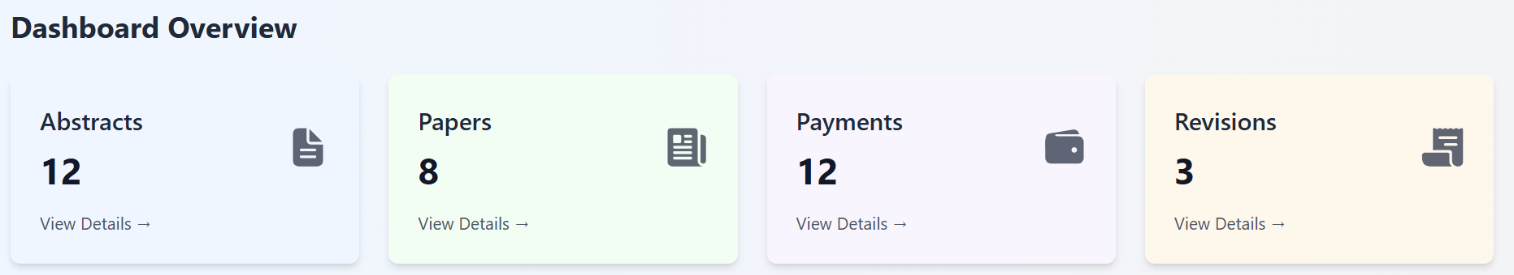
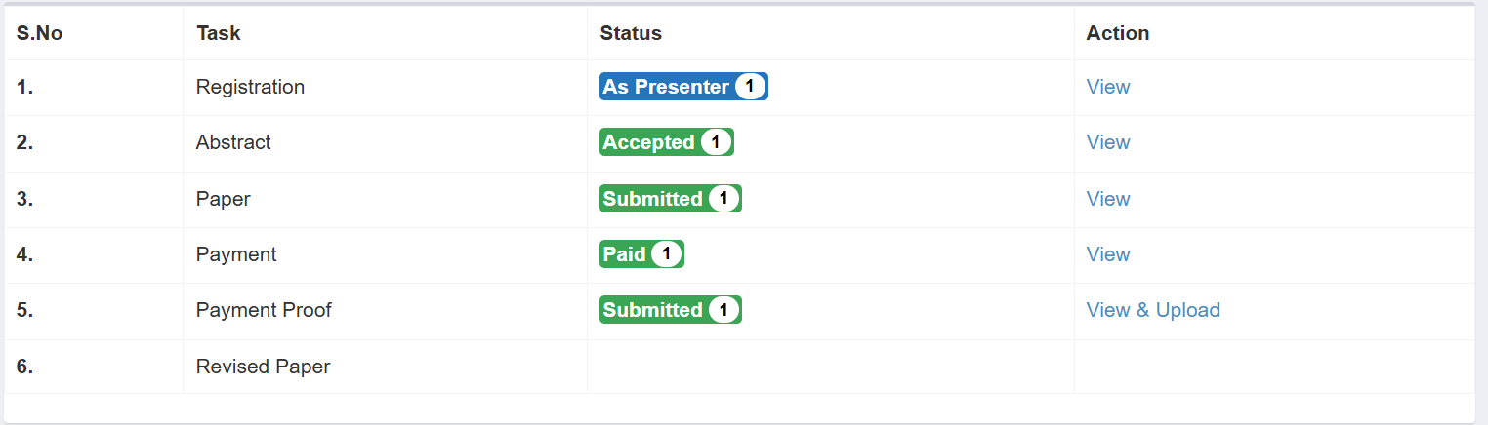
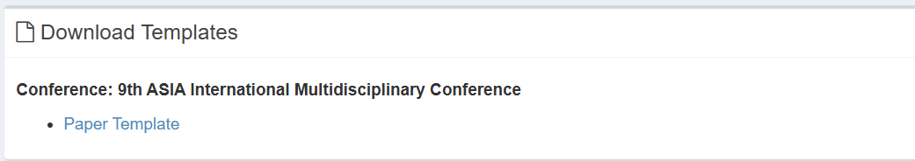
EGE CMS
EGE CMS
Notification
Logout
Madni
Dashboard (Home)
EGE Conference 2020/2022/2025
Conference Registration
Abstract
Papers
Recent Submissions
Payment
Scheduling
Pending
Certificate
Camera Ready Paper
Messages
Sign out

Slide 2
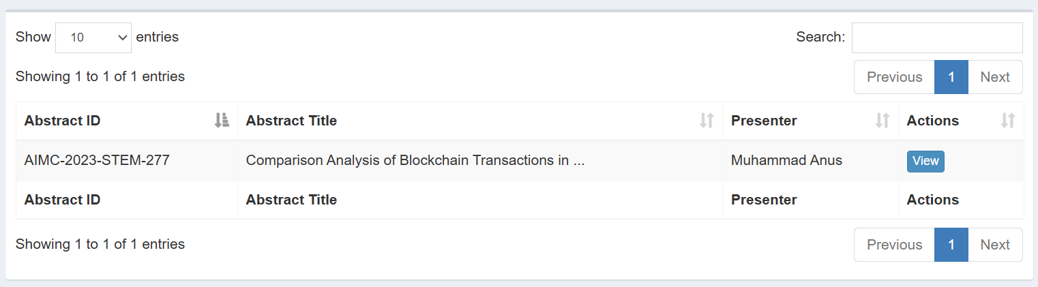
EGE CMS
EGE CMS
Logout
Madni
Dashboard (Home)
EGE Conference 2020/2022/2025
Conference Registration
Presenter
Abstract
Papers
Payment
Submit Your Abstract
Scheduling
Certificate
Messages
Sign out

Slide 3
EGE CMS
EGE CMS
Logout
Madni
Dashboard (Home)
EGE Conference 2020/2022/2025
Registration
Presenter
Abstract
Papers
Phyiscial /Online
Payment
Scheduling
Certificate
Schedule will be Update Soon
Messages
Sign out
EGE-2025 Schedule

Slide 4
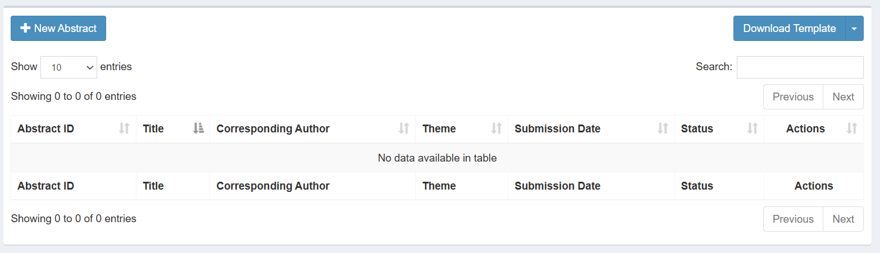
EGE CMS
EGE CMS
Logout
Madni
Dashboard (Home)
EGE Conference 2020/2022/2025
Conference Registration
Submit New Abstract
Abstract
Papers
Payment
Scheduling
Show the list of abstract otherwise show nothing
Certificate
Messages
Sign out

Slide 5
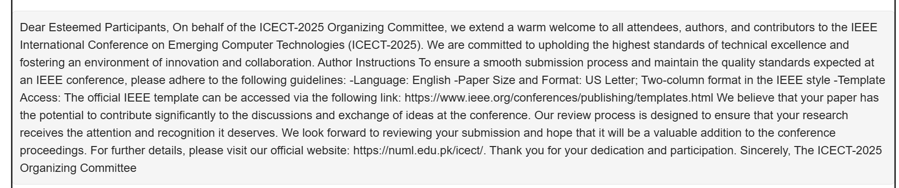
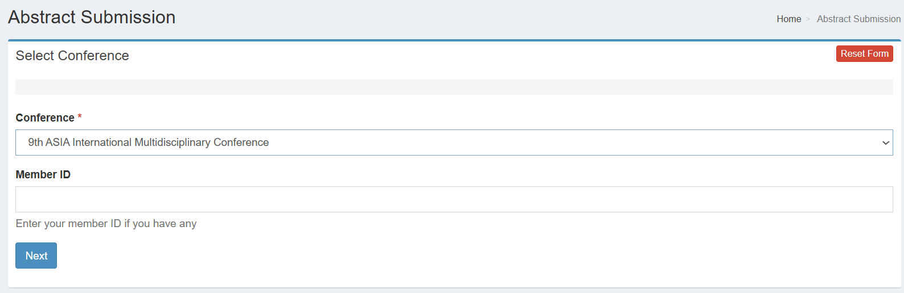
EGE CMS
EGE CMS
Logout
Madni
Dashboard (Home)
Submit New Abstract
EGE Conference 2020/2022/2025
Abstract Submission
Conference Registration
Abstract
Papers
Payment
Scheduling
Certificate
Messages
Sign out

Slide 6
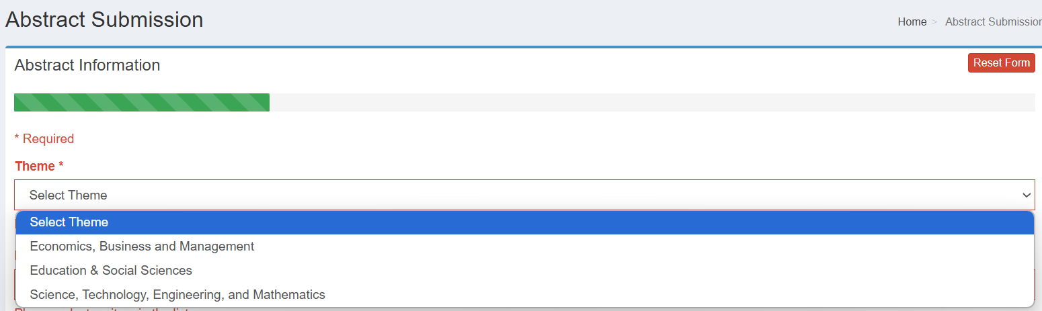
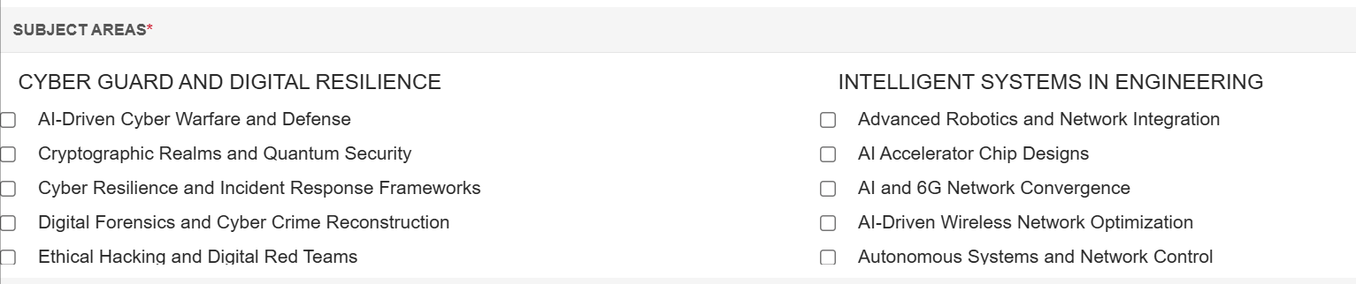
EGE CMS
EGE CMS
Logout
Madni
Dashboard (Home)
Submit New Abstract
EGE Conference 2020/2022/2025
Conference Registration
Abstract Submission
Abstract
Papers
Payment
Scheduling
Certificate
Select Track
Messages
Sign out

Slide 7
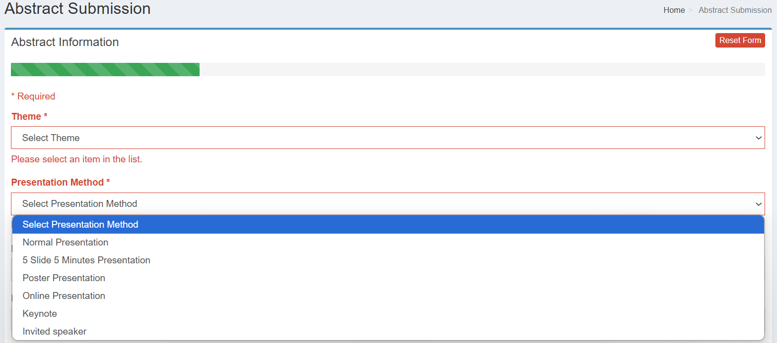
EGE CMS
EGE CMS
Logout
Madni
Dashboard (Home)
Submit New Abstract
EGE Conference 2020/2022/2025
Abstract Submission
Conference Registration
Abstract
Papers
Payment
Scheduling
Certificate
Messages
Sign out

Slide 8
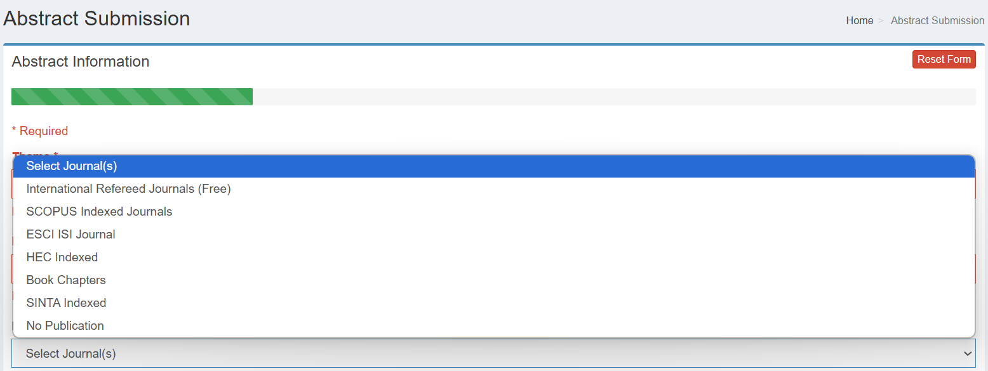
EGE CMS
EGE CMS
Logout
Madni
Dashboard (Home)
Submit New Abstract
EGE Conference 2020/2022/2025
Conference Registration
Abstract Submission
Abstract
Papers
Payment
Scheduling
Certificate
Messages
Sign out

Slide 9
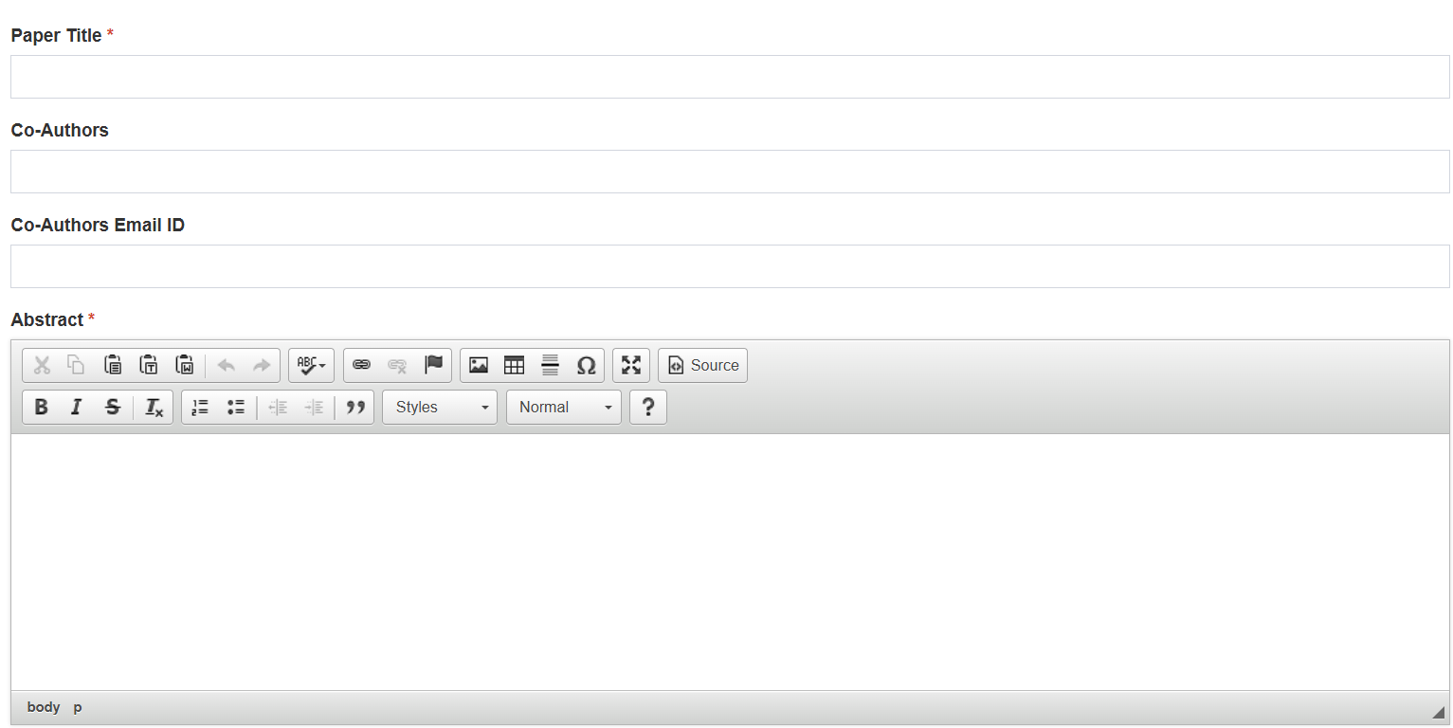
EGE CMS
EGE CMS
Logout
Madni
Dashboard (Home)
Submit New Abstract
EGE Conference 2020/2022/2025
Conference Registration
Abstract Submission
Abstract
Papers
Payment
Scheduling
Certificate
Keywords (4 to 6 words separated by commas)
Messages
Sign out

Slide 10
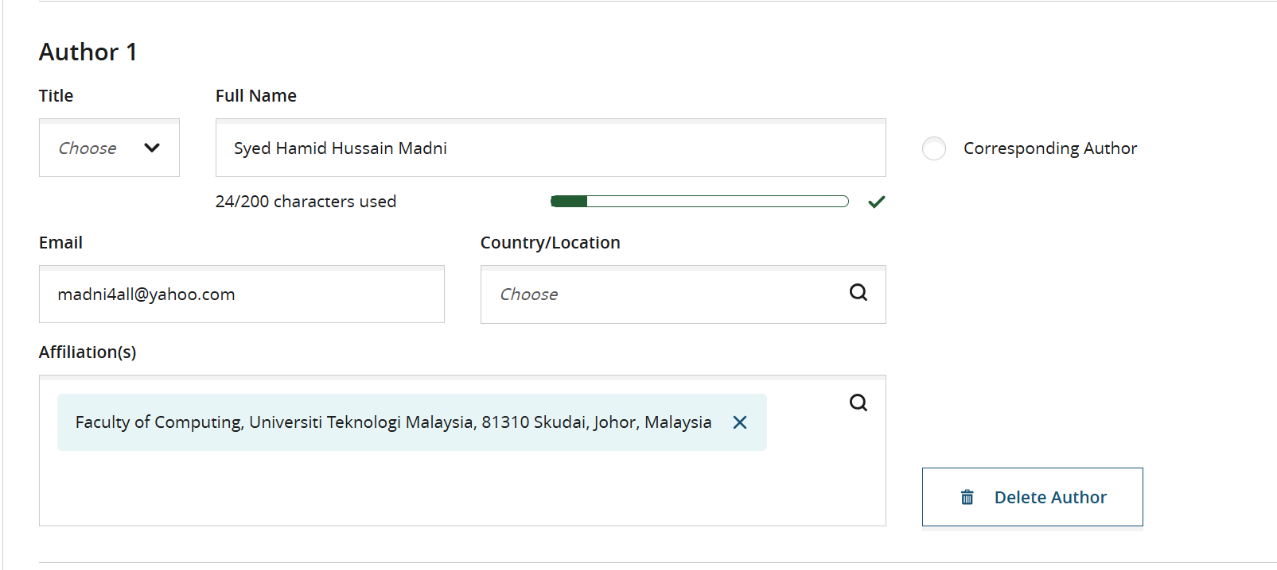
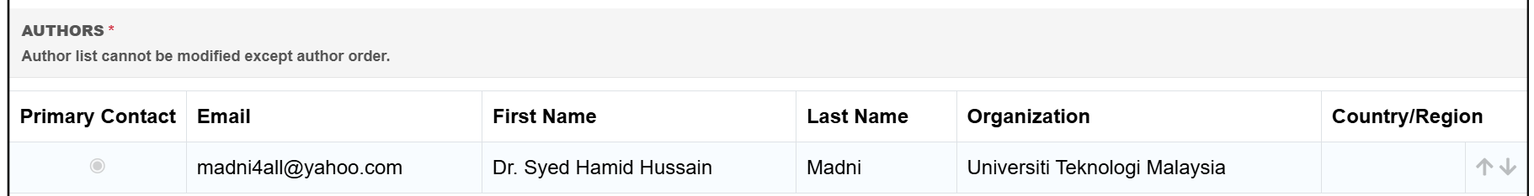

EGE CMS
EGE CMS
Logout
Madni
Dashboard (Home)
Submit New Abstract
EGE Conference 2020/2022/2025
Conference Registration
Abstract Submission
Abstract
Papers
Show information from the registration login
Payment
Scheduling
Show information Edit registration login
Certificate
Messages
Sign out

Slide 11
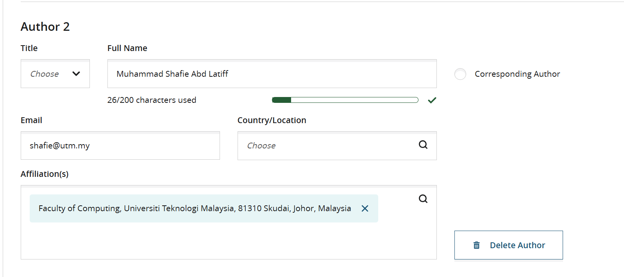
EGE CMS
EGE CMS
Logout
Madni
Dashboard (Home)
Submit New Abstract
EGE Conference 2020/2022/2025
Conference Registration
Abstract Submission
Abstract
Papers
Payment
Scheduling
Add
Certificate
Messages
Sign out

Slide 12
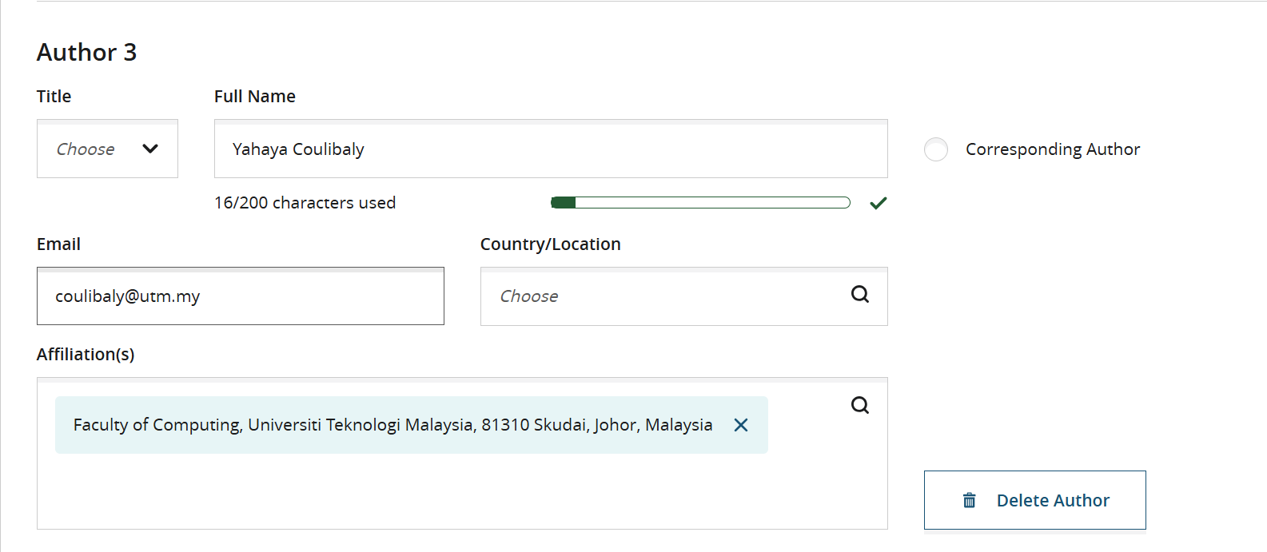
EGE CMS
EGE CMS
Logout
Madni
Dashboard (Home)
Submit New Abstract
EGE Conference 2020/2022/2025
Conference Registration
Abstract Submission
Add Authors
Abstract
Papers
Payment
Add
Scheduling
Certificate
Messages
Sign out

Slide 13
EGE CMS
EGE CMS
Logout
Madni
Dashboard (Home)
Submit New Abstract
EGE Conference 2020/2022/2025
Conference Registration
Abstract Submission
Add Authors
Abstract
Papers
Payment
Scheduling
Certificate
Messages
Sign out

Slide 14
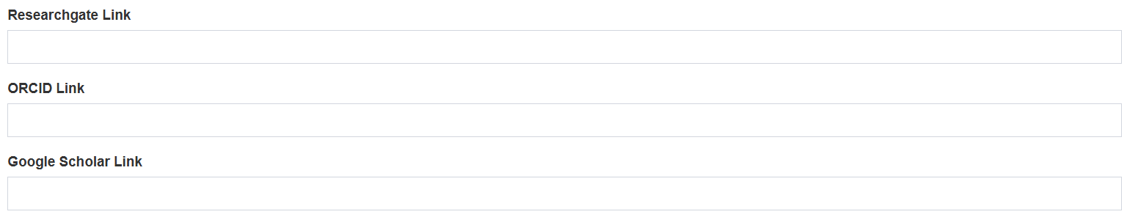
EGE CMS
EGE CMS
Logout
Madni
Dashboard (Home)
Submit New Abstract
EGE Conference 2020/2022/2025
Conference Registration
Abstract Submission
Abstract
Papers
Payment
Scheduling
Certificate
Messages
Sign out

Slide 15
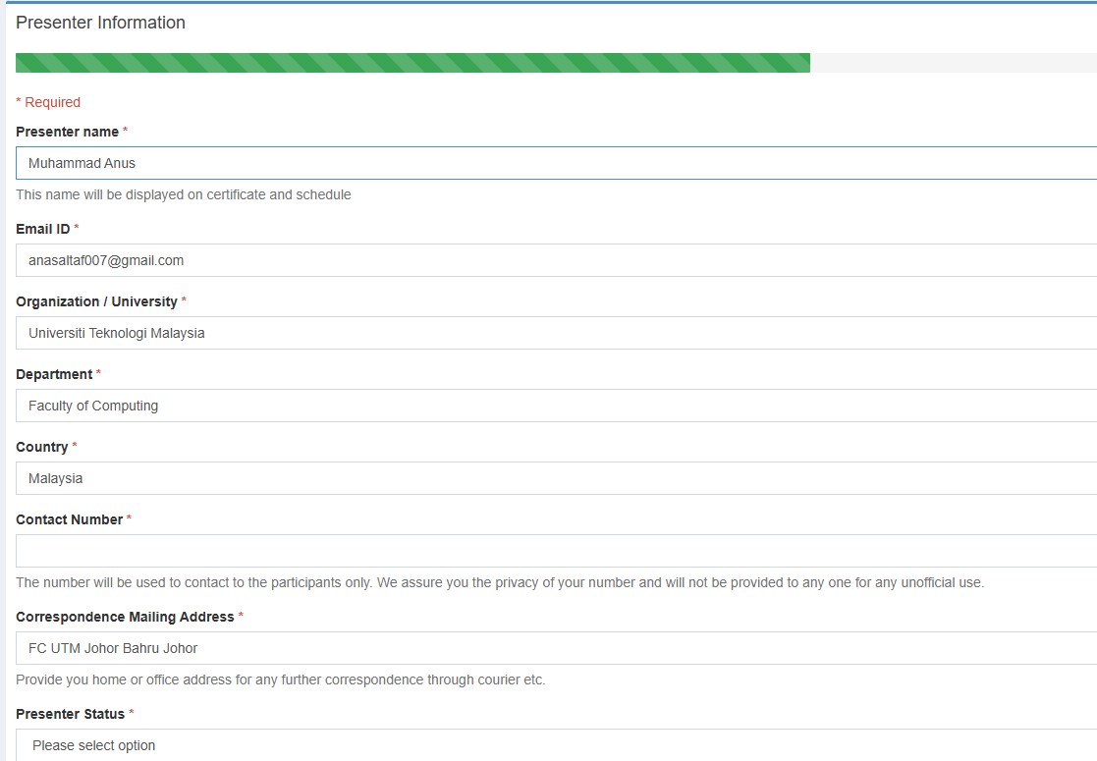
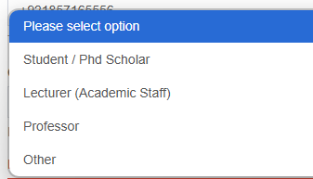
EGE CMS
EGE CMS
Logout
Madni
Dashboard (Home)
EGE Conference 2020/2022/2025
Conference Registration
Submit New Abstract
Presenter Information
Abstract
Papers
Payment
Scheduling
Certificate
Messages
Sign out

Slide 16
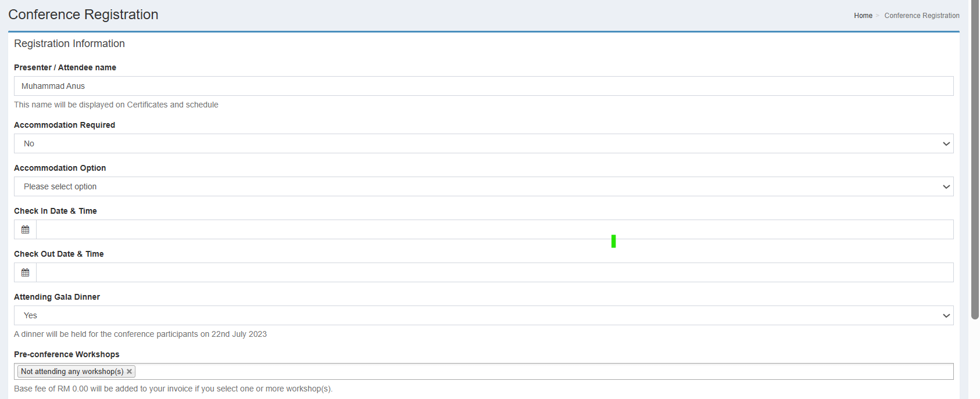
EGE CMS
EGE CMS
Logout
Madni
Dashboard (Home)
EGE Conference 2020/2022/2025
Submit New Abstract
Conference Registration
Conference Registration
Abstract
Papers
Payment
Scheduling
Certificate
Messages
Sign out
Review
Submit

Slide 17
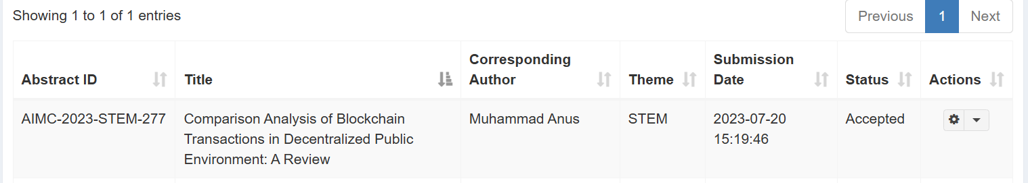
EGE CMS
EGE CMS
Logout
Madni
Dashboard (Home)
EGE Conference 2020/2022/2025
Conference Registration
Submit New Abstract
Abstract
Papers
Submitted
Payment
Scheduling
Email 1: Automatic Received the email that “Your abstract has been successfully submitted after review the abstract you will receive the email of acceptance or rejection”
Certificate
Messages
Sign out

Slide 18
EGE CMS
EGE CMS
Logout
Madni
Dashboard (Home)
EGE Conference 2020/2022/2025
Conference Registration
Submit New Abstract
Abstract
Papers
Submitted
Payment
Scheduling
Email 2: After 24 hour, Automatic Received the email that “Congratulations! Your abstract has been accepted for the EGE-2025, please pay the registration fee of the conference as soon as possible and upload the proof the payment and send the link
Certificate
Messages
Sign out

Slide 19
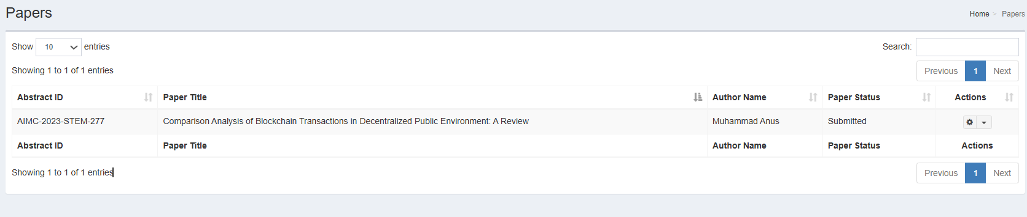
EGE CMS
EGE CMS
Logout
Madni
Dashboard (Home)
EGE Conference 2020/2022/2025
Conference Registration
Abstract
Papers
Payment
Abstract ID
Title
Submission Date
Status
Action
Scheduling
Abstract Submitted
Paper Submitted or not
In Review
Accepted
Rejected
Minor Revision
Major Revision
Revision Submitted
Camera Ready Copy Submitted
Withdraw
View
Upload Paper
Certificate
Messages
Sign out

Slide 20
EGE CMS
EGE CMS
Logout
Madni
Dashboard (Home)
EGE Conference 2020/2022/2025
Poster
Conference Registration
Abstract
Poster
Payment
Abstract ID
Title
Submission Date
Status
Action
Scheduling
Abstract Submitted
Poster Submitted or not
Withdraw
View
Upload Poster
Certificate
Messages
Sign out

Slide 21
EGE CMS
EGE CMS
Logout
Madni
Dashboard (Home)
EGE Conference 2020/2022/2025
Conference Registration
Payment
Abstract
Papers
Upload the Payment Proof
Payment
Scheduling
Certificate
Messages
Sign out

Slide 22
EGE CMS
EGE CMS
Logout
Madni
Dashboard (Home)
EGE Conference 2020/2022/2025
Conference Registration
Payment
Abstract
Papers
View
Payment
Scheduling
Certificate
Messages
Sign out

Slide 23
EGE CMS
EGE CMS
Logout
Madni
Dashboard (Home)
EGE Conference 2020/2022/2025
Registration
Schedule
Abstract
Papers
Payment
Scheduling
Certificate
Schedule will be Update Soon
Messages
EGE-2025 Schedule
Sign out
Only available for Active or Upcoming Conference

Slide 24
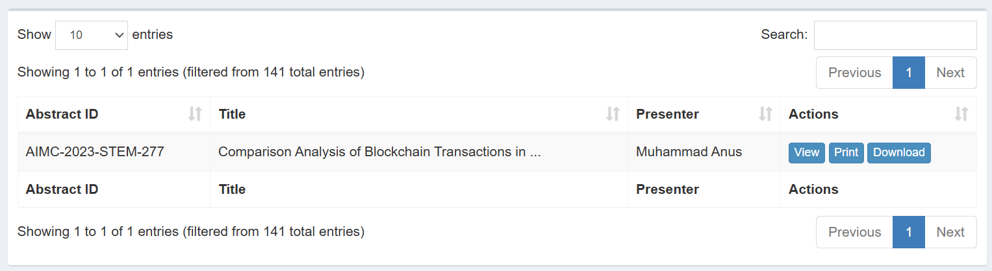
EGE CMS
EGE CMS
Logout
Madni
Dashboard (Home)
EGE Conference 2020/2022/2025
Registration
Certificate
Abstract
Papers
Payment
View
Scheduling
Certificate
Messages
Sign out

Slide 25
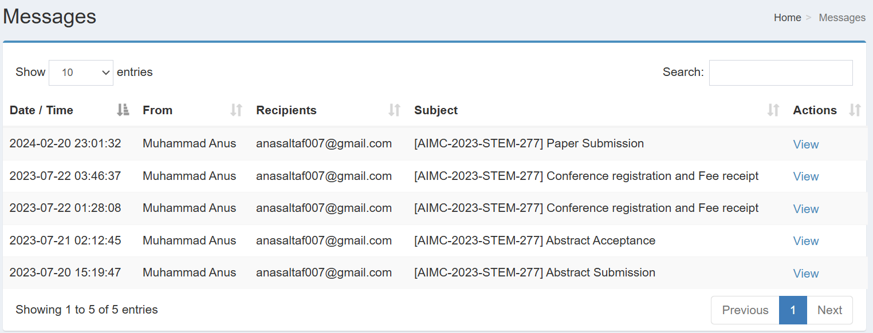
EGE CMS
EGE CMS
Logout
Madni
Dashboard (Home)
EGE Conference 2020/2022/2025
Registration
Messages
Abstract
Papers
Payment
View
Scheduling
Certificate
Messages
Sign out

